Slide 2
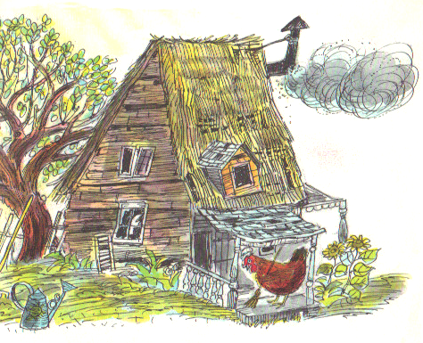
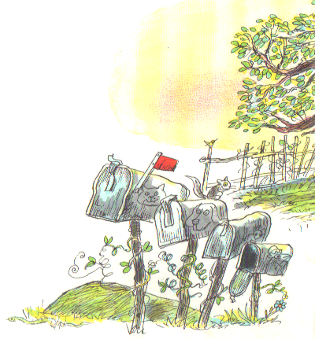
Once upon a time
a cat and a dog and a mouse
and a little red hen
all lived together in a cozy little house.

Slide 3
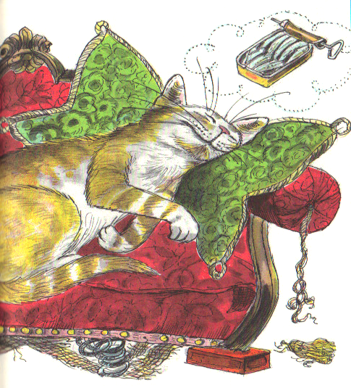
The cat liked to sleep all day on the soft couch.

Slide 4
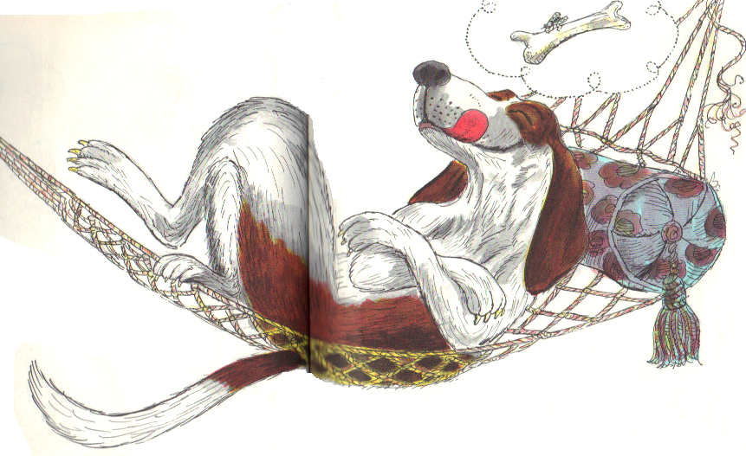
The dog liked to nap all day on the sunny back porch.

Slide 5
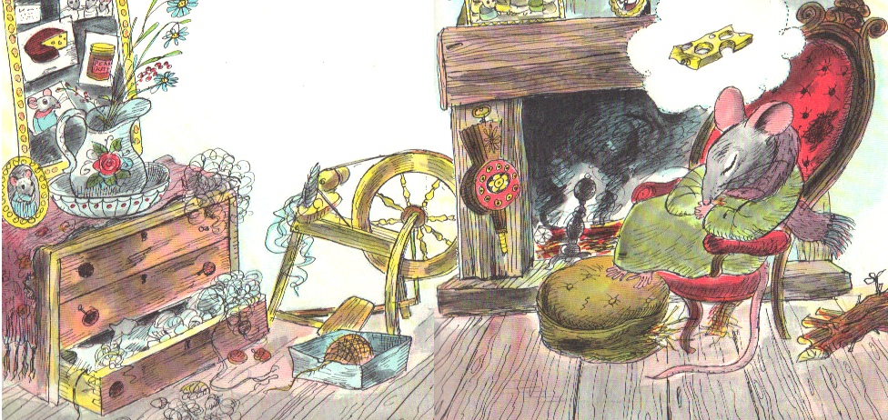
And the mouse liked to snooze all day in the warm chair by the fireside.

Slide 6
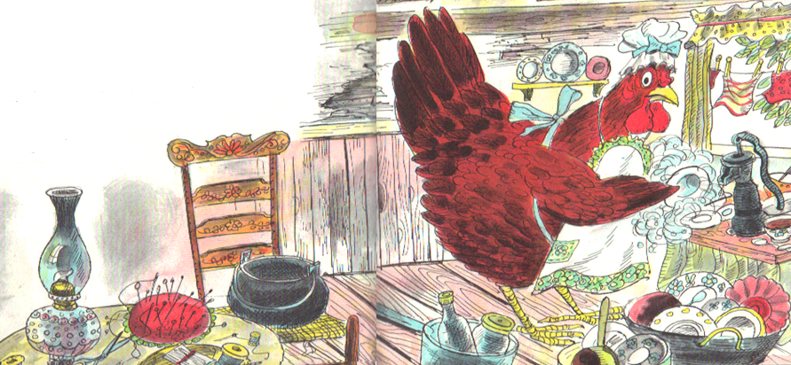
So the little red hen had to do all the housework.
She cooked the meals and washed the dishes and made the beds. She swept the floor and washed the windows and mended the clothes.

Slide 7
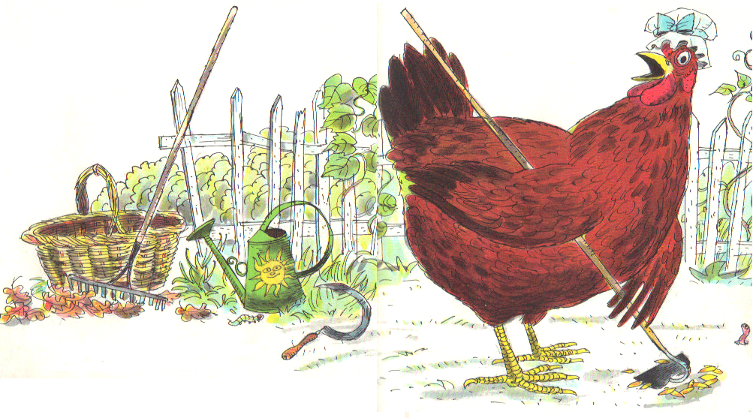
She raked the leaves and mowed the grass and hoed the garden.
One day, when she was hoeing the garden, she found some grains of wheat. “Who will plant this wheat?”, cried the little red hen.

Slide 8
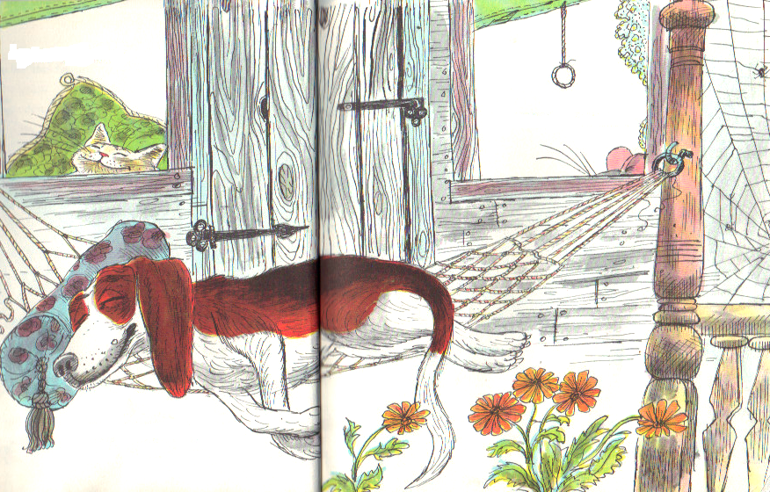
“Not I,” said the cat.
“Not I,” said the mouse.
“Not I,” said the dog.

Slide 9
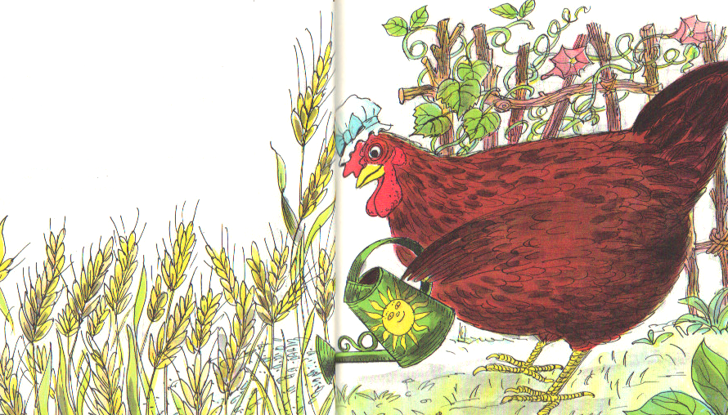
“Then, I will,” said the little red hen. And she did.
Each morning, the little red hen watered the wheat and pulled the weeds.
Soon the wheat pushed through the ground and began to grow tall.

Slide 10
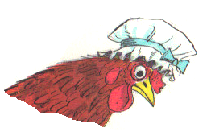
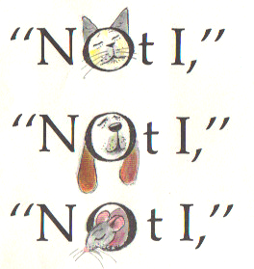
When the wheat was ripe, the little red hen asked, Who will cut this wheat?”
said the cat.
said the dog.
said the mouse.

Slide 11
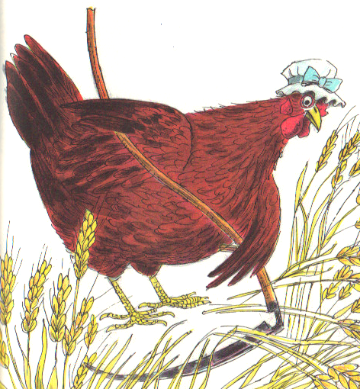
“Then, I will,” said the little red hen. And she did.

Slide 12
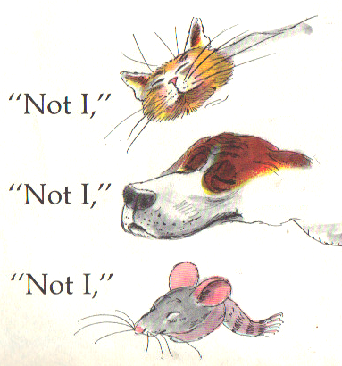
When the wheat was all cut, the little red hen asked, “Now, who will take this wheat to the mill to be ground into flour?”
said the cat.
said the dog.
said the mouse.

Slide 13
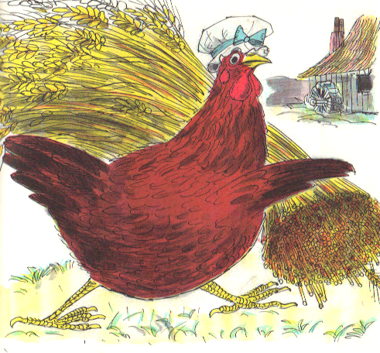
“Then, I will,” said the little red hen. And she did.

Slide 14
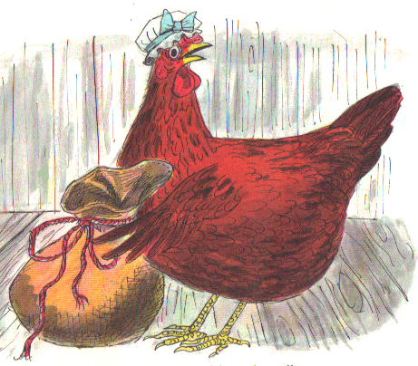
The little red hen returned from the mill carrying a small bag of fine white flour. “Who will make a cake from this fine white flour?”, asked the little red hen.

Slide 15
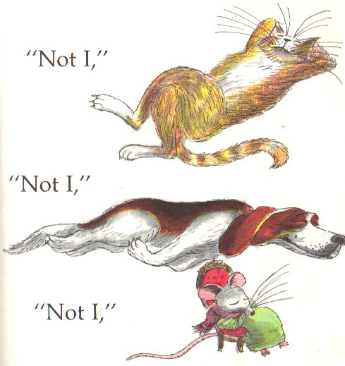
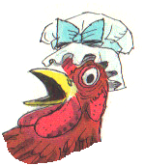
said the cat.
said the dog.
said the mouse.
“Then, I will,” said the little red hen. And she did.

Slide 16
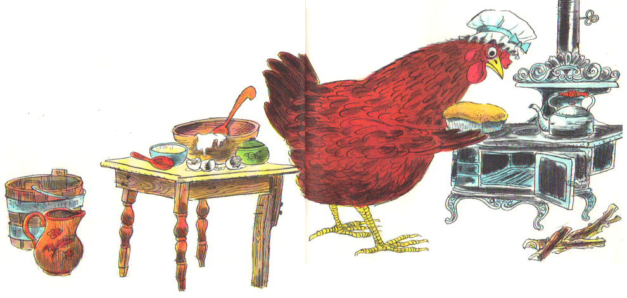
She gathered sticks and made a fire in the stove. Then she took milk and sugar and eggs and butter and mixed them in a big bowl with the fine white flour.
When the oven was hot she poured the cake batter into a shining pan and put it in the oven.

Slide 17
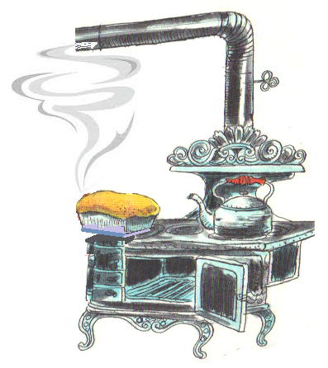
Soon a delicious smell filled the cozy little house.

Slide 18
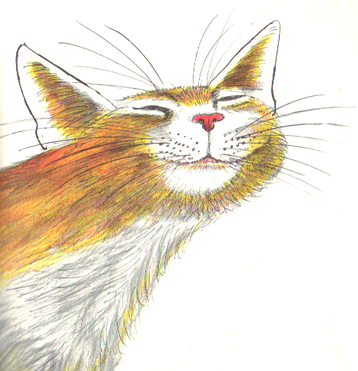
The cat got off the soft couch and strolled into the kitchen.

Slide 19
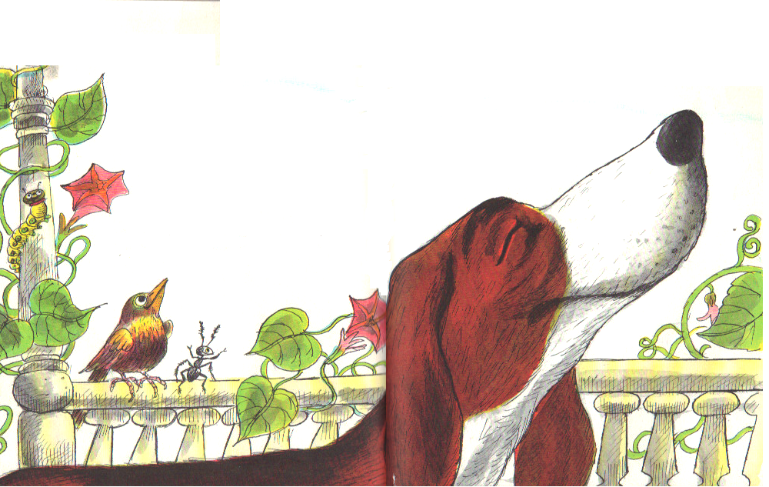
The dog got up from the sunny back porch and came into the kitchen.

Slide 20
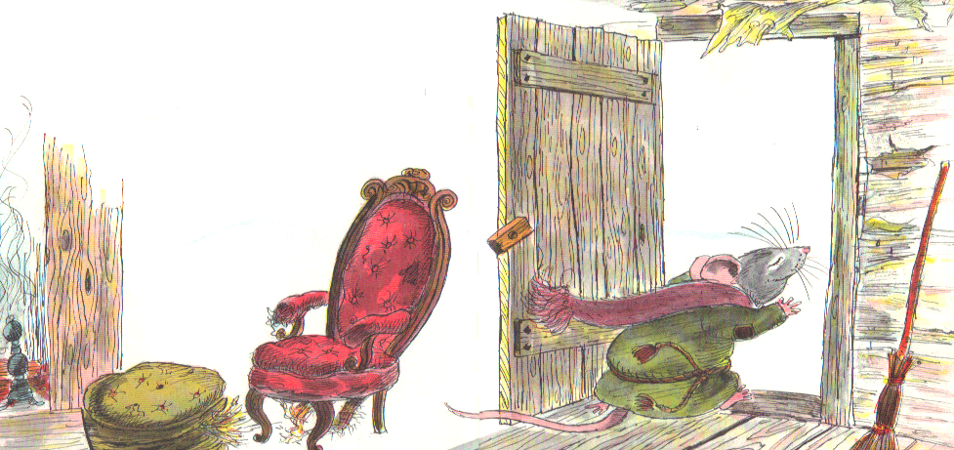
The mouse jumped down from his warm chair and scampered into the kitchen.

Slide 21
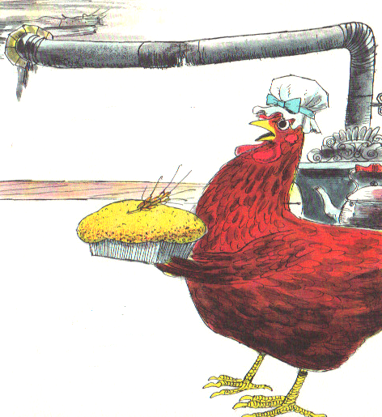
The little red hen was just taking a beautiful cake out of the oven.
“Who will eat this cake?”, asked the little red hen.

Slide 22
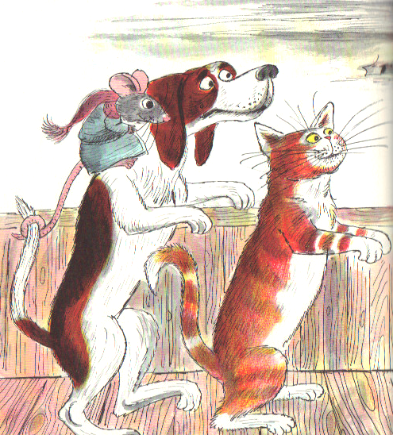
“I will,” said the cat.
“I will,” said the dog.
“I will,” said the mouse.

Slide 23
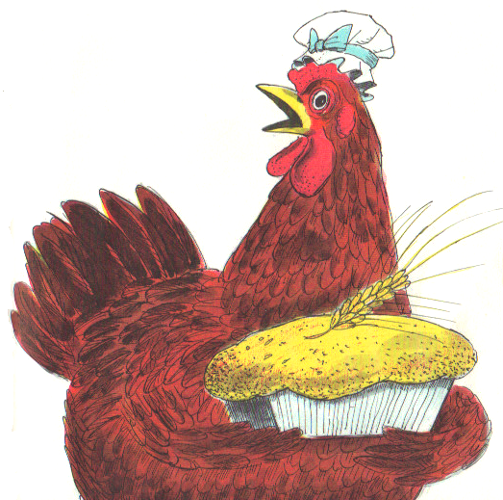
But the little red hen said,
“All by myself
I planted the wheat,
I tended the wheat,
I cut the wheat,
I took the wheat to the mill
to be ground into the flour.”

Slide 24
“All by myself
I gathered the sticks,
I built the fire,
I mixed the cake.
And all myself I am going to eat it!”

Slide 25
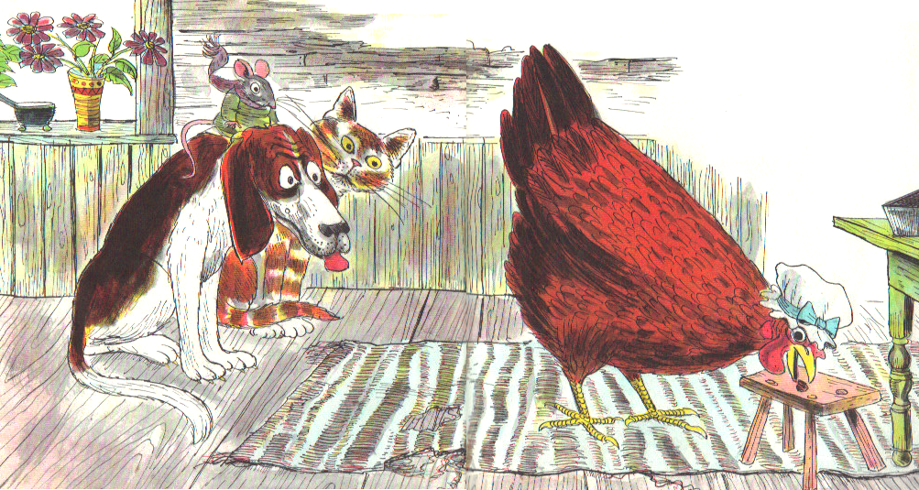
And so she did, to the very last crumb.
After that,

Slide 26
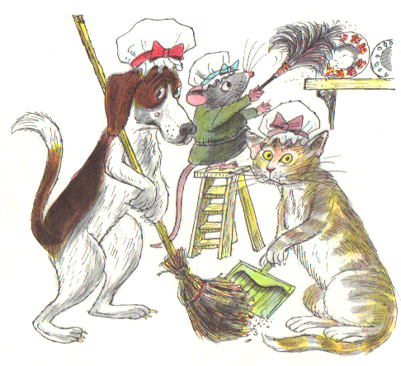
Whenever there was work to be done, the little red hen had three very eager helpers.

Slide 27
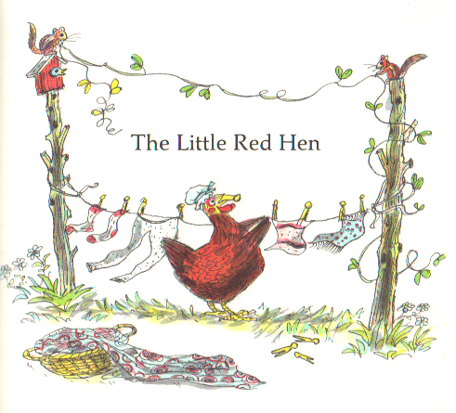
The End

